Slide 1
Additional Budgeting Concepts– Special Budgets
September 22, 2022
Wenchen Wang

Slide 2
Last Week
Missions and Strategic Plan for Public Service Organizations
Budget
Definition
Types
Process
Master Budget
Operating budget
Cash budget
Capital budget
Financial Budget
Notes:
We talked about the elements of how to write the mission statement of the public service organizations, and we talked about the strategic plans of the organizations, how the plan needs to account for different goals of the public service organizations: direct; indirect; expansion goals; and how the strategic plan should incorporate the long-range plan which spread out the general strategic plan of the organizations into a long term and into the day-to-day activities of the organization.
The operating budget presents a plan for revenues and expenses for the fiscal year
Cash Accounting recognizes
Revenues when payments are received in cash
Expenses when resources are paid in cash
Accrual Accounting recognizes
Revenues when good or services have been delivered and the organization has earned the right to be paid
Expenses when resources have been used in the operation
The cash budget plans for the cash receipts and disbursements of the organization. The capital budget plans for cash receipts and payments specifically for resources that will provide service for a period longer than just the coming year, such as buildings and equipment.

Slide 3
Budgets
Special Types of Budgets
Flexible budget
Zero-based budget
Performance budget
Special-purpose budget
Line-item budget
Responsibility center budget
Program budget
Functional budget
Budgeting Techniques
Budgeting Formats

Slide 4
Budgeting Formats
Line Item
e.g., salaries, benefits, supplies, rent, etc.
Limited ability to implement and control
Responsibility Center
Units for which individual managers are held accountable, e.g., custodial services, maintenance, public relations, development, ticket sales, etc.
Difficult to control spending
A combination of these two provides managers with more information and ability to control spending
Notes:
Line item: A line-item budget is one in which the individual financial statement items are grouped by category.
A responsibility center approach divides the budget into units for which individual managers are are wholly responsible for managing their own revenues and expenditures.

Slide 5
Line-Item Operating Budget
Revenue
Net patient revenue
Gift shop revenue
Investment revenue
on endowment
Total revenue
Expenses
Salaries
Supplies
Bad debts
Interest
Rent
Total expenses
Profit/(loss)
$ 97,980,000
120,000
50,000
$ 98,150,000
$ 78,900,000 15,400,000
2,200,000
400,000
3,100,000
$100,000,000
$ (1,850,000)

Slide 6
Responsibility Center Expense Budget
Hospital - Expense Budget for the Coming Fiscal Year
Radiology | $ 13,000,000
Nursing | $ 10,000,000
Pharmacy | $ 5,000,000
Laboratory | $ 7,000,000
Operating Room | $ 50,000,000
Administration | $ 15,000,000
Total | $100,000,000

Slide 7
Line-Item and Responsibility Center Expense Budget
Hospital for Ordinary Surgery Expense Budget for the Coming Fiscal Year
 | Radiology | Nursing | Pharmacy | Laboratory | Operating Room | Administration | Total
Salaries | $ 3,700,000 | $ 8,000,000 | $ 1,300,000 | $ 4,000,000 | $ 32,000,000 | $ 11,000,000 | $ 60,000,000
Supplies | $ 3,600,000 | $ 1,200,000 | $ 3,500,000 | $ 2,500,000 | $ 13,700,000 | $ 500,000 | $ 25,000,000
Utilities | $ 3,400,000 | $ 100,000 | $ 100,000 | $ 200,000 | $ 400,000 | 100,000 | 4,300,000
Rent | $ 2,300,000 | $ 700,000 | $ 100,000 | $ 300,000 | $ 3,900,000 | $ 400,000 | $ 7,700,000
Interest | $ 0 | $ 0 | $ 0 | $ 0 | $ 0 | $ 3,000,000 | $ 3,000,000
Total | $13,000,000 | $10,000,000 | $5,000,000 | $7,000,000 | $50,000,000 | $15,000,000 | $100,000,000
Notes:
There can also be a combination of line-item budget and the functional budget (see Exercise 3.31)

Slide 8
Centralization VS. Decentralization
Top-down Budget
Top Management—Middle Management—Line Managers
Bottom-up Budget
Line Managers– Middle Management—Top Management
Often times within an organization, it would be a hybrid of both of these two approaches.
Notes:
In general, all budgets will start with some input from top management. Broad policy goals are formulated by top executives, policy makers, and, in the case of government, political representatives. These goals should reflect public needs and preferences as well as the mission and strategy of the organization. Most organizations then incorporate their responsibility center managers into the process by asking unit or department heads to prepare detailed budgets, incorporating the broad objectives that top management has provided. Top-down has a speed advantage. Decisions can be proposed, adopted, and implemented with a minimum of delay. In times of crisis, speed may be a critical element. The primary disadvantage is that it is much harder to get cooperation and commitment from the people at all levels of the organization to carry out the budget.
A bottom-up approach allows the individuals who are most involved with the day-to-day activities and specific aspects of the organization’s operations to be involved in the planning process. This empowerment of employees often leads to better morale and better results. However, it requires top managers who are willing to accept some degree of decentralization. Bottom-up budgeting is better for gaining consensus and support for the budget. However, not only is it time-consuming, but also it creates the need for negotiation and compromise. It works better when times are stable than in times of crisis or significant change. Risk of losing sight of overall objectives.

Slide 9
Performance Budget
Managers can see the cost of achieving different outcomes, instead of focusing primarily on inputs.
Asks managers to
Define goals
Plan their resource needs
Measure the achievement of various goals and objectives
Notes:
Performance budgeting is an approach designed to improve the budget process by focusing more on what the organization hopes to accomplish.
Performance budgeting is a useful approach in situations that do not have a clear relationship between resources and outcomes. The method calls on the manager and organization to define goals, plan the amount of resources needed to accomplish those goals, and then assess how well the goals have been achieved.

Slide 10
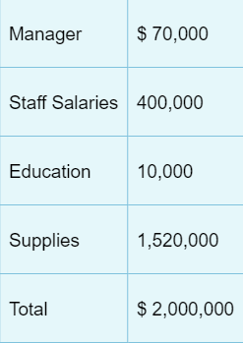
Special Budget Example
Assume that the regular expenses in an operating budget is as below:

Slide 11
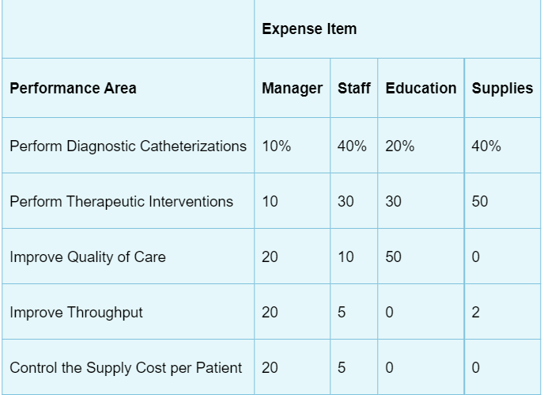
Special Budget Example
Devote percentage of resources to each performance area:

Slide 12
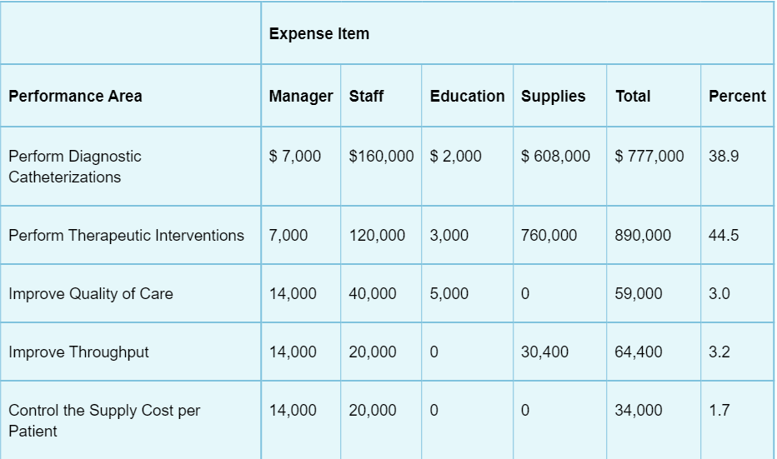
Special Budget Example
Allocate operating budget to performance areas:

Slide 13
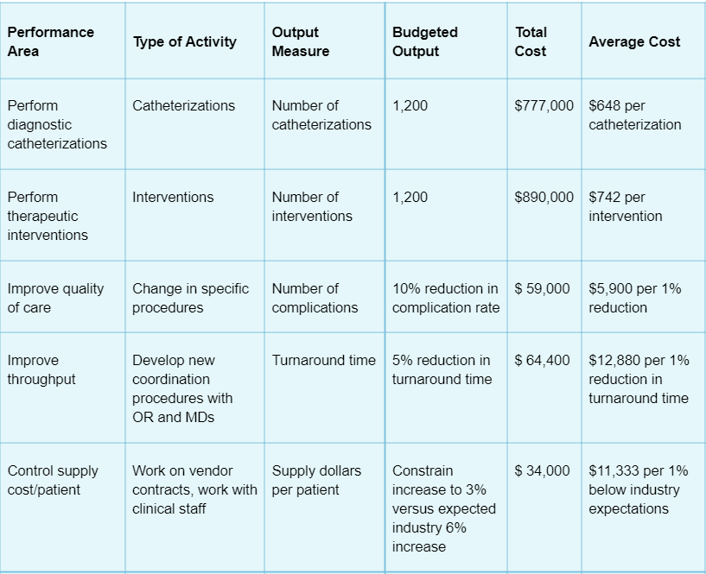
Special Budget Example

Slide 14
Special Budget Example
The $34,000 amount shown the example is for the cost of controlling supply cost at 3% to be below the expected industrywide increase of 6%. Is the saving worth the investment (The supplies budget in total is $1,520,000)?
Cost-benefit analysis of savings per dollar spent:
Savings/Cost
Return on investment =(Savings-Cost)/Cost
What if the total cost of supplies is only $500,000?
Profit
Notes:
the $34,000 cost of controlling supply costs divided by the 3 percent expected benefit = $11,333 for each percent savings below the industry average
Performance budgeting allows the manager to calculate the return on investment for various activities undertaken by the department. For example, the supplies budget for this department, shown earlier, is $1,520,000. Each 1 percent difference in the cost of supplies will cost the hospital $15,200 (i.e., $1,520,000 × 1 percent = $15,200). On a savings-to-cost basis, the calculation would be:
Savings/Cost = $15,200/$11,333 = $1.34
savings per dollar spent.
For every dollar the department spends to control supply costs, it saves $1.34 in the cost of supplies.
The return on investment would be the profit from the activity divided by the cost of the activity ($15,200 – $11,333 = $3,867/$11,333=34%):
Note, however, that if the department consumed only $500,000 of supplies per year, the effort would not be worthwhile. Each percent reduction in supply cost would yield a savings of only $5,000 ($500,000 cost × 1 percent = $5,000):
Savings/Cost = $5,000/$11,333 = $0.44
savings per dollar spent.
In other words, the organization would get back only 44 cents for each dollar invested. This would indicate that it would be better off not using resources for this effort. The savings/cost ratio must exceed 1.0 for the action to result in a positive financial benefit.
On the other hand, the organization may choose to allocate resources to outcomes that are desirable for other qualitative reasons, even if they do not yield positive financial results. Public service organizations must always consider whether there are other reasons to do things beyond strictly financial ones.

